Slide 1
Ttest Results
Ran a ttest (post/pre) for all electrodes
Pre stim (-200 - 0)
Post stim (0 – 200)
All trials
Frequency depends on click frequency (25,50,100,125,150,200)
Only plotted Values that had a pvalue smaller than 0.05

Slide 2
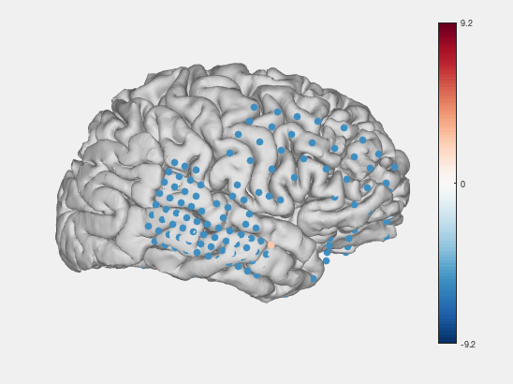
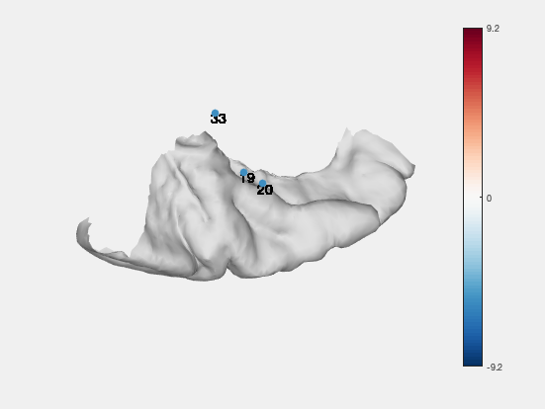
25 Hz

Slide 3
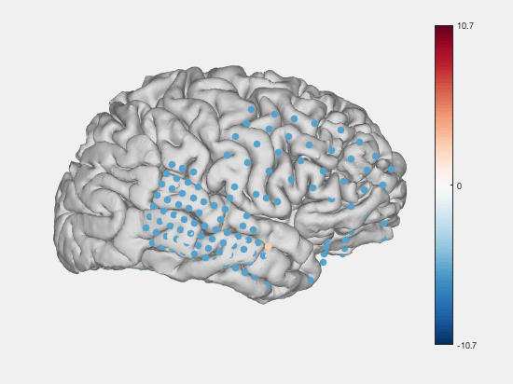
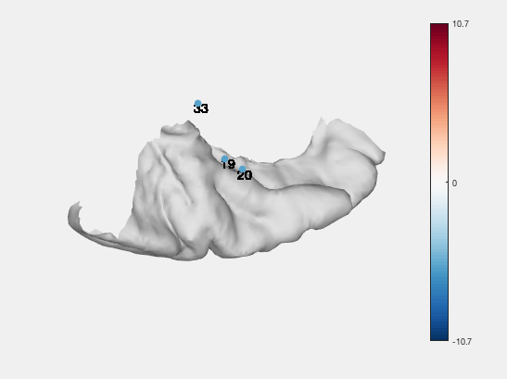
50 Hz

Slide 4
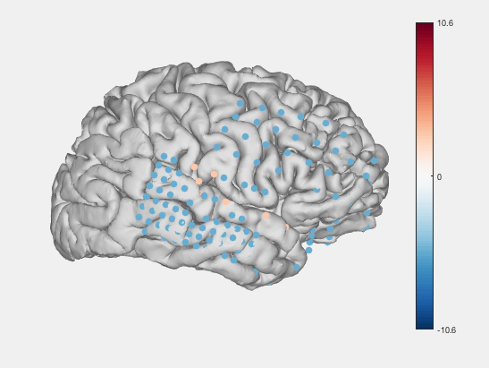
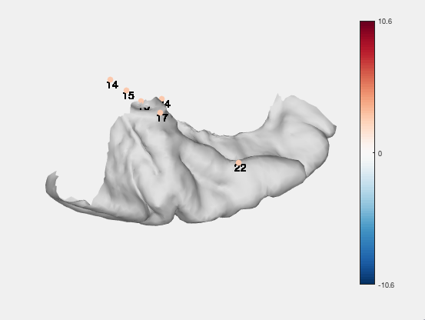
100 Hz

Slide 5
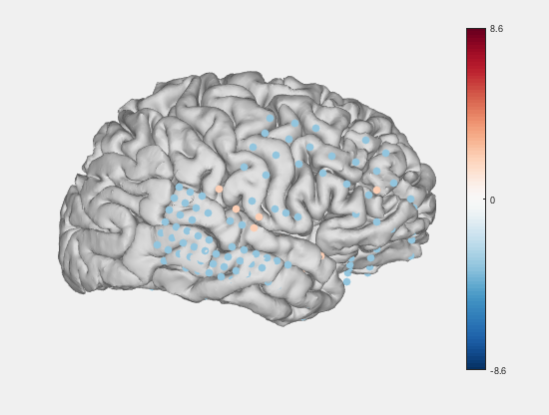

125 Hz

Slide 6
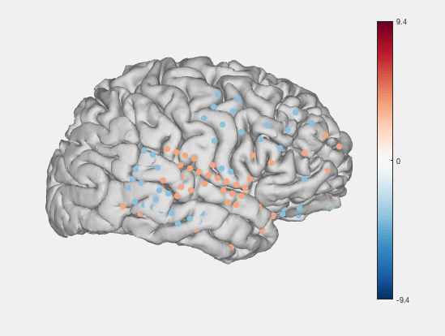
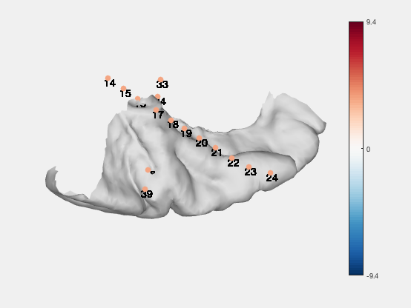
150 Hz

Slide 7
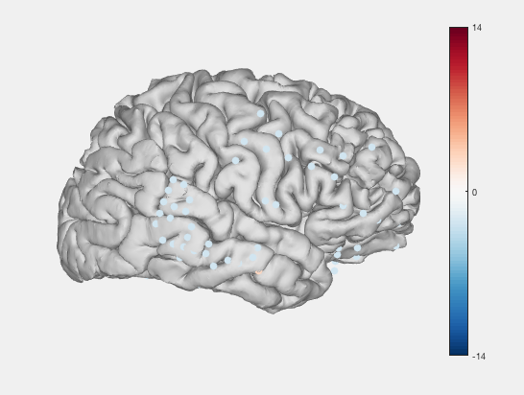
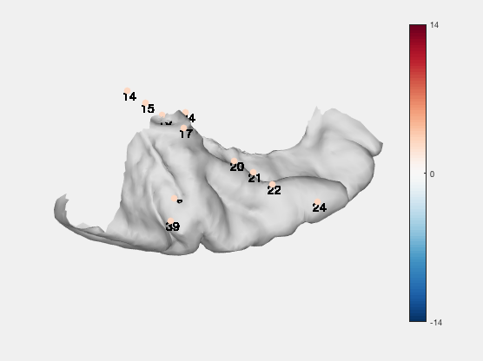
200 Hz

